Slide 1


Anime Recommendation System
by OTAKU OASIS

Slide 2
Introduction
This project focuses on creating a collaborative and content-based recommender system for anime titles. By leveraging historical preferences, we aim to predict user ratings for anime shows.
Nm

Slide 3

Meet The Team
Sandiso Magwaza – Team Lead
Sharon Ramapuputla- Project Manager
Siphosethu Rululu- Github Manager
Amanda Mokoena – Data Analyst
Kgolo Motshegoa - Data Scientist
Nkhubalale Nkadimeng- Data Engineer

Slide 4

Data Collection
This dataset contains information on anime content (movies, television series, music, specials, OVA, and ONA*)
1
Data Acquisition
Open source Kaggle dataset
2
Data Source
(https://www.kaggle.com/datasets/CooperUnion/anime-recommendations-database)
3
Datasets
Anime.csv, training.csv, test.csv

Slide 5

Preprocessing
The initial step involves gathering data on anime titles and user ratings from various sources like online databases and APIs.
1
Data Inspection
df.info(), df.describe(), df.isnull().sum(), df.head()
2
Data Cleaning
Handling missing values, inconsistent data, and outliers.
3
Data Transformation
Normalizing and scaling data for better model performance.

Slide 6
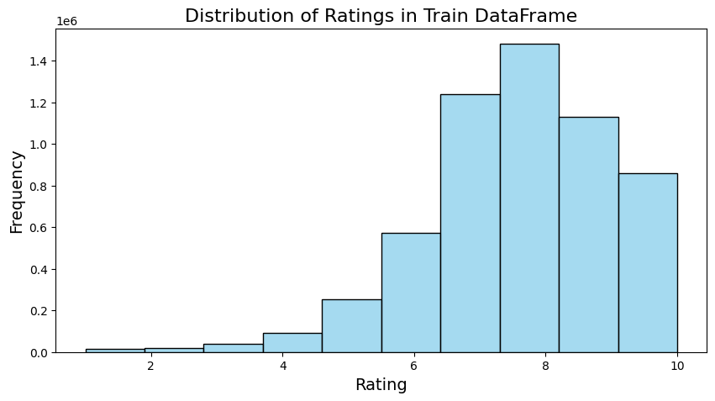
EXPLORATORY DATA ANALYSIS
Exploratory Data Analysis is the process of using visual and statistical methods to understand the underlying structure and patterns in a dataset.
Visualizations: Distribution of ratings and most rated anime. Genre distribution and average ratings. Correlation between ratings and popularity (members).
.
.

Slide 7
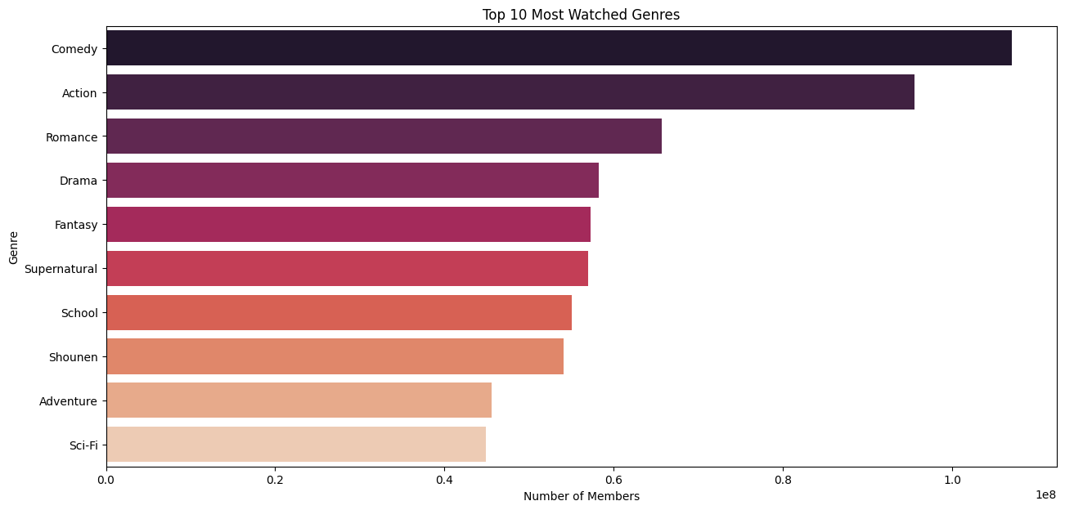
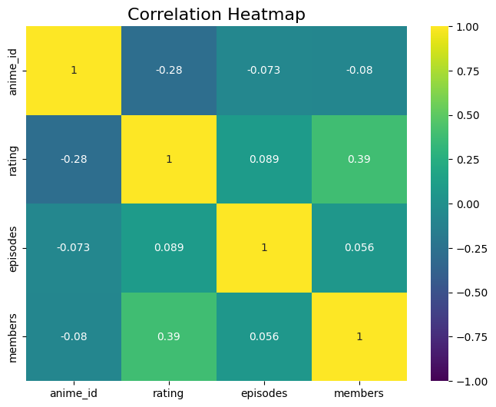
.
.

Slide 8

Feature Engineering
This step focuses on creating relevant features from the collected data and choosing the most suitable machine learning model for predictions.
Dimensionality Reduction
- Principal Component Analysis (PCA)
Normalization and Scaling
- Min-Max Scaling
Feature Selection Methods
- Variance Threshold, Correlation Matrix

Slide 9
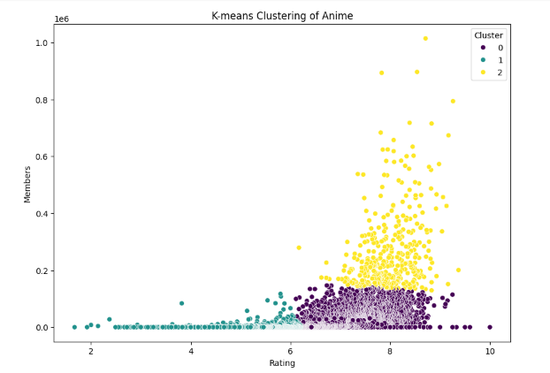
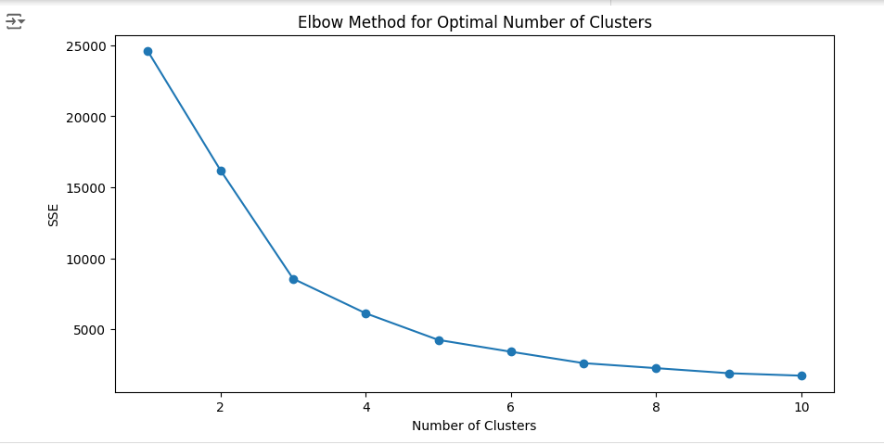
Model Selection
K-Means
Elbow Method

Slide 10
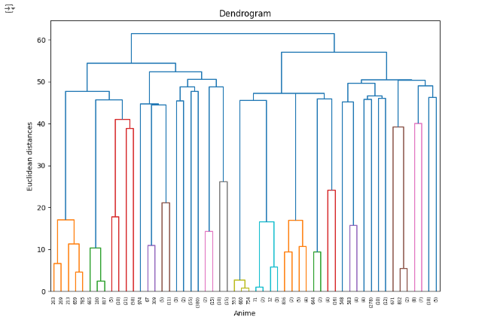
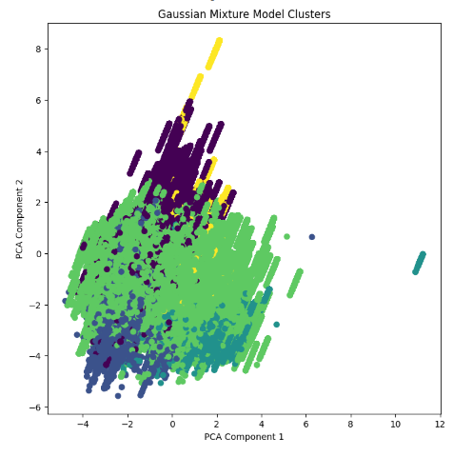
Model Selection
Hierarichal Clustering
Gaussian Mixture Models

Slide 11

Collaborative Filtering Approach
This approach leverages similarities between users' preferences to generate recommendations. It analyzes past ratings and interactions to find users with similar tastes.
1
User-based Filtering
Recommends anime based on the ratings of users with similar tastes.
2
Item-based Filtering
Suggests anime based on the ratings of other users who liked similar titles.

Slide 12
Content-Based Recommendation Techniques
This approach suggests anime based on the characteristics of the current title, analyzing its features, genres, and themes.
Genre Similarity
Character Traits
Themes and Plot
Recommends anime based on similar genres to the ones the user enjoys.
Suggests anime with characters sharing traits with those the user likes.
Recommends anime with similar themes and plot elements.

Slide 13
Model Evaluation
Evaluation Metric: Root Mean Squared Error (RMSE)
Model | RMSE
SVD Tuned | 1.385
SVD | 1.439
Collaborative Filtering | 2.698
Content-Based Filtering | 2.698

Slide 14




Streamlit: Building Interactive Apps
Streamlit is a Python library that simplifies the process of building interactive web apps for data science projects.
User Interface
Creating a user-friendly interface for search, browsing, and personalized recommendations.
Data Visualization
Displaying anime details, ratings, and recommendations using interactive charts and graphs.
Real-time Predictions
Integrating the trained model to provide recommendations based on user preferences.
https://nkhubalale-recommendation-system-app-izOvxz.streanlit.app/

Slide 15

Deployment and User Interface
The developed recommender system is deployed on a web server, making it accessible to users for real-time recommendations.
User Authentication
Allows users to create profiles and save their preferences.
Recommendation Engine
Provides personalized anime suggestions based on user ratings and viewing history.
User Feedback
Enables users to provide feedback on recommendations, improving the system's accuracy.

Slide 16






Conclusion and Future Enhancements
The project successfully developed a collaborative and content-based recommender system for anime titles.
Improved Accuracy
Explore advanced algorithms and techniques for more accurate predictions.
Future plans
Improve recommendations & future upgrades .
Community Integration
Incorporate user reviews and social interactions to enhance the recommendation experience.
Otaku Oasis
https://nkhubalale-recommendation-system-app-izOvxz.streanlit.app/

